Slide 1
CS 2420: Binary Heap
Dr. Tsung-Wei (TW) Huang
Department of Electrical and Computer Engineering
University of Utah, Salt Lake City, UT

Slide 2
Outline
In this topic, we will:
Define a binary min-heap
Look at some examples
Operations on heaps:
Top
Pop
Push
An array representation of heaps
Define a binary max-heap
Using binary heaps as priority queues

Slide 3
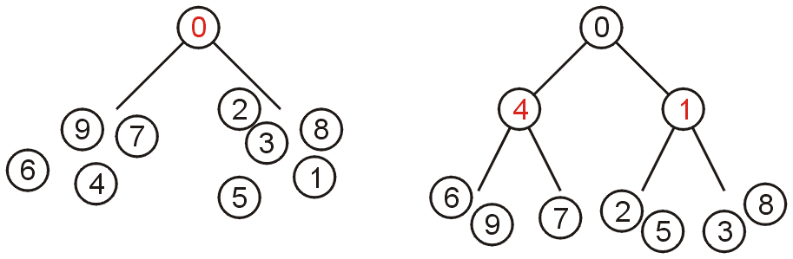
Definition
A non-empty binary tree is a min-heap if
The key associated with the root is less than or equal to the keys associated with either of the sub-trees (if any)
Both of the sub-trees (if any) are also binary min-heaps
From this definition:
A single node is a min-heap
All keys in either sub-tree are greater than the root key

Slide 4
Definition
Important:
THERE IS NO OTHER RELATIONSHIP BETWEEN
THE ELEMENTS IN THE TWO SUBTREES
Failing to understand this is the greatest mistake a student makes

Slide 5
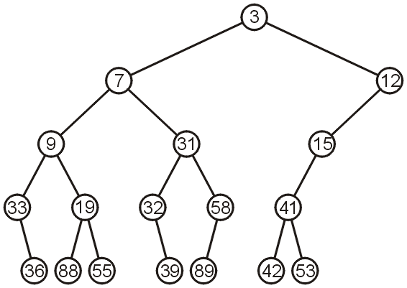
Example
This is a binary min-heap:

Slide 6
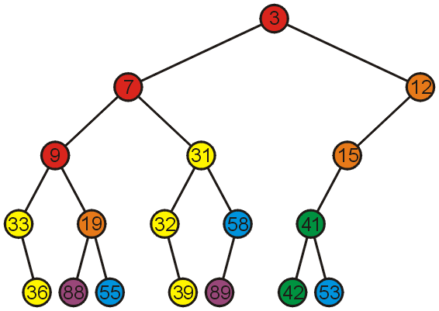
Example
Adding colour, we observe
The left subtree has the smallest (7) and the largest (89) objects
No relationship between items with similar priority

Slide 7
Operations
We will consider three operations:
Top
Pop
Push
Notes:
7

Slide 8
Example
We can find the top object in Θ(1) time: 3

Slide 9
Pop
To remove the minimum object:
Promote the node of the sub-tree which has the least value
Recurs down the sub-tree from which we promoted the least value

Slide 10
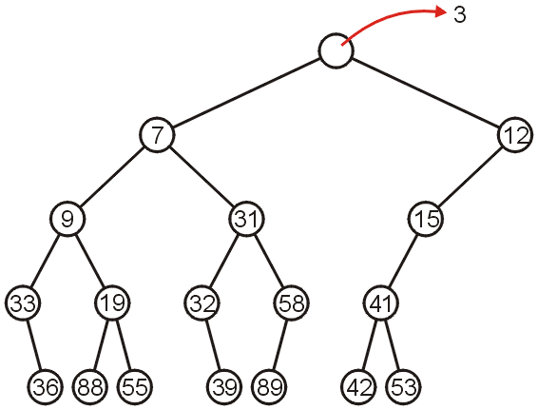
Pop
Using our example, we remove 3:

Slide 11
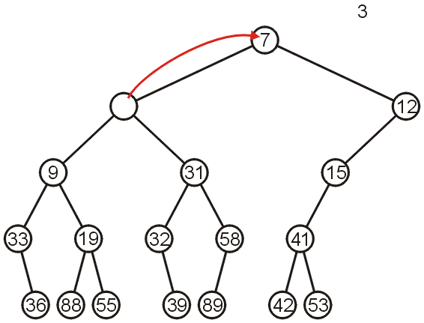
Pop
We promote 7 (the minimum of 7 and 12) to the root:

Slide 12
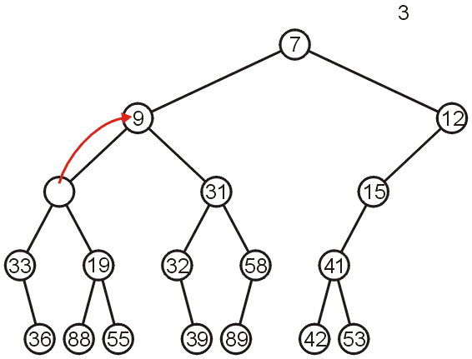
Pop
In the left sub-tree, we promote 9:

Slide 13
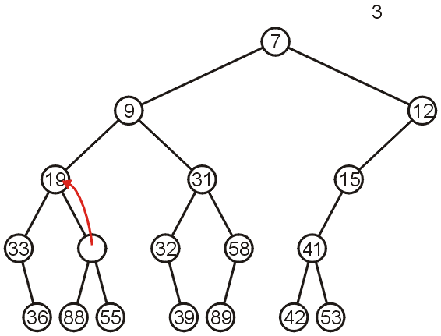
Pop
Recursively, we promote 19:

Slide 14
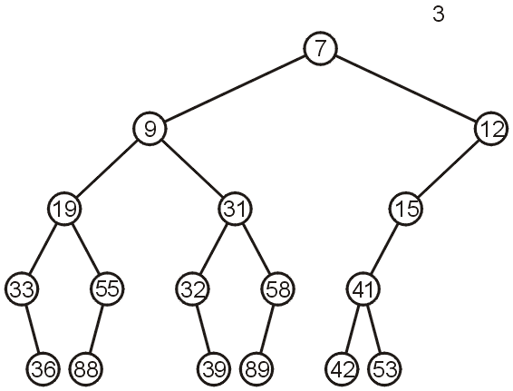
Pop
Finally, 55 is a leaf node, so we promote it and delete the leaf

Slide 15
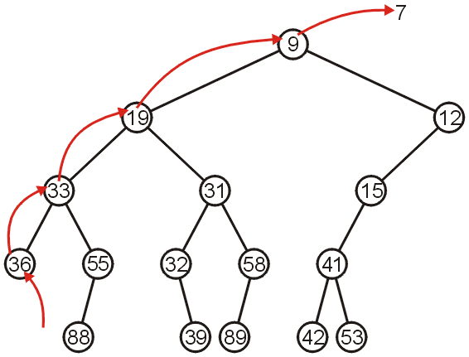
Pop
Repeating this operation again, we can remove 7:

Slide 16
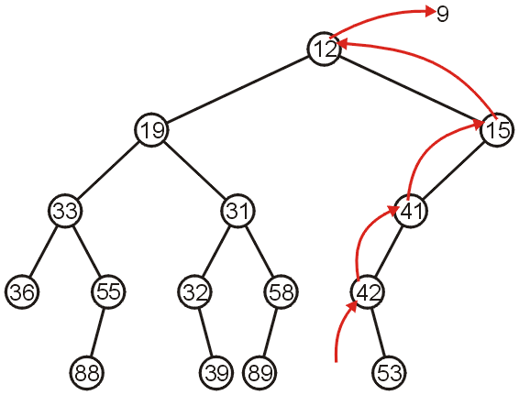
Pop
If we remove 9, we must now promote from the right sub-tree:

Slide 17
Push
Inserting into a heap may be done either:
At a leaf (move it up if it is smaller than the parent)
At the root (insert the larger object into one of the subtrees)
We will use the first approach with binary heaps
Other heaps use the second

Slide 18
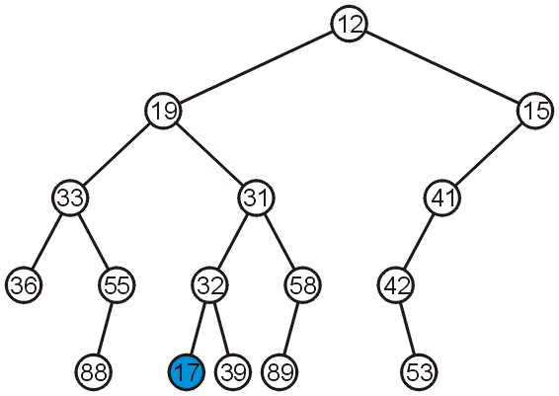
Push
Inserting 17 into the last heap
Select an arbitrary node to insert a new leaf node:

Slide 19
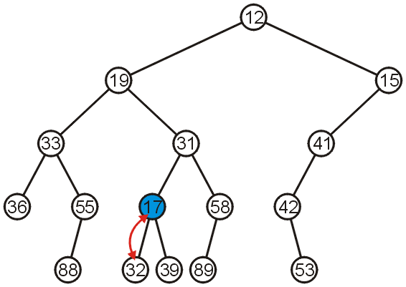
Push
The node 17 is less than the node 32, so we swap them

Slide 20
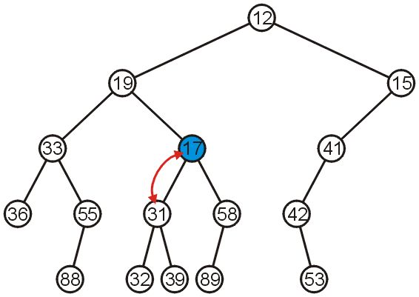
Push
The node 17 is less than the node 31; swap them

Slide 21
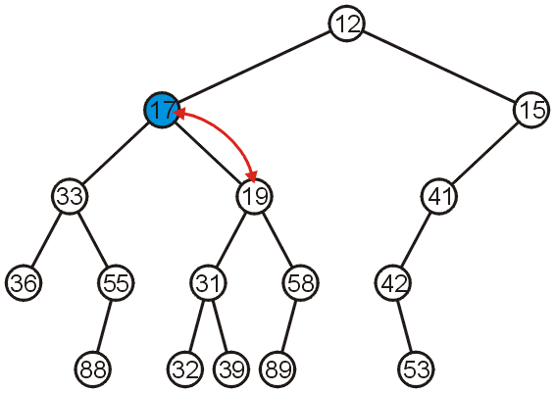
Push
The node 17 is less than the node 19; swap them

Slide 22
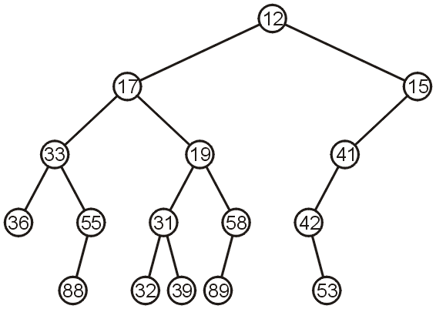
Push
The node 17 is greater than 12 so we are finished

Slide 23
Push
Observation: both the left and right subtrees of 19 were greater than 19, thus we are guaranteed that we don’t have to send the new node down
This process is called percolation, that is, the lighter (smaller) objects move up from the bottom of the min-heap

Slide 24
Implementations
With binary search trees, we introduced the concept of balance
From this, we looked at:
AVL Trees
B-Trees
Red-black Trees (not course material)
How can we determine where to insert so as to keep balance?

Slide 25
Implementations
There are multiple means of keeping balance with binary heaps:
Complete binary trees
Leftist heaps
Skew heaps
We will look at using complete binary trees
In has optimal memory characteristics but sub-optimal run-time characteristics

Slide 26
Complete Trees
By using complete binary trees, we will be able to maintain, with minimal effort, the complete tree structure
We have already seen
It is easy to store a complete tree as an array
If we can store a heap of size n as an array of size Θ(n), this would be great!

Slide 27
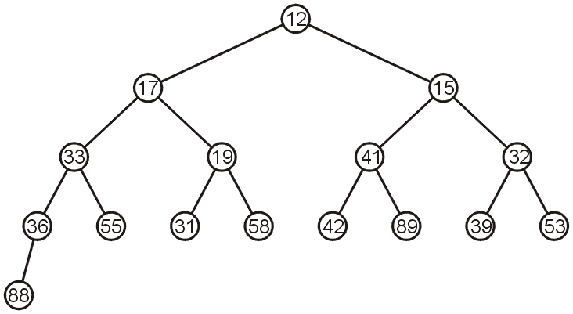
Complete Trees
For example, the previous heap may be represented as the following (non-unique!) complete tree:

Slide 28
Complete Trees: Push
If we insert into a complete tree, we need only place the new node as a leaf node in the appropriate location and percolate up

Slide 29
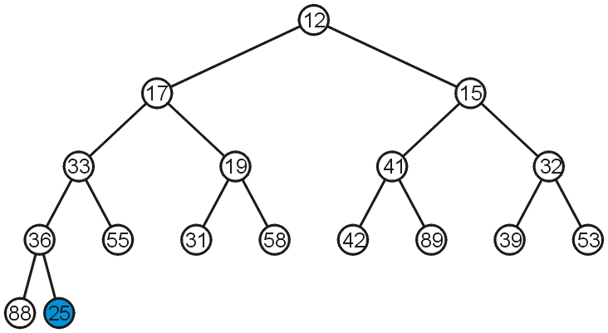
Complete Trees: Push
For example, push 25:

Slide 30
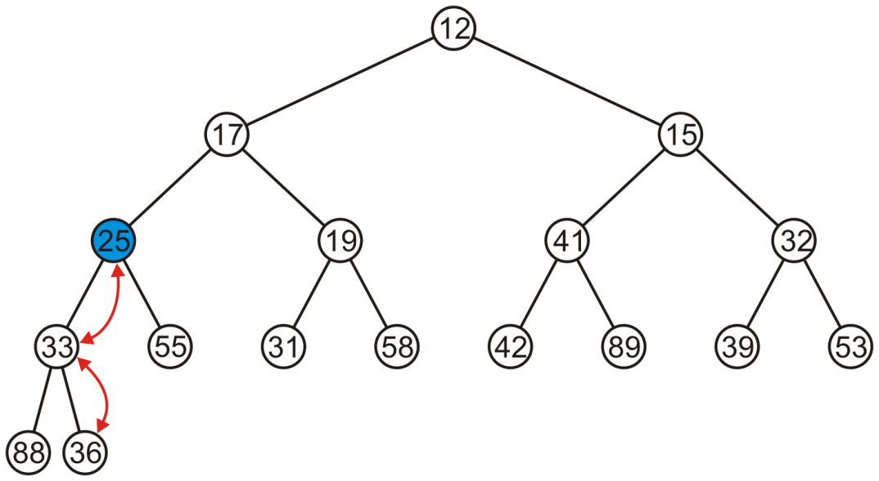
Complete Trees: Push
We have to percolate 25 up into its appropriate location
The resulting heap is still a complete tree

Slide 31
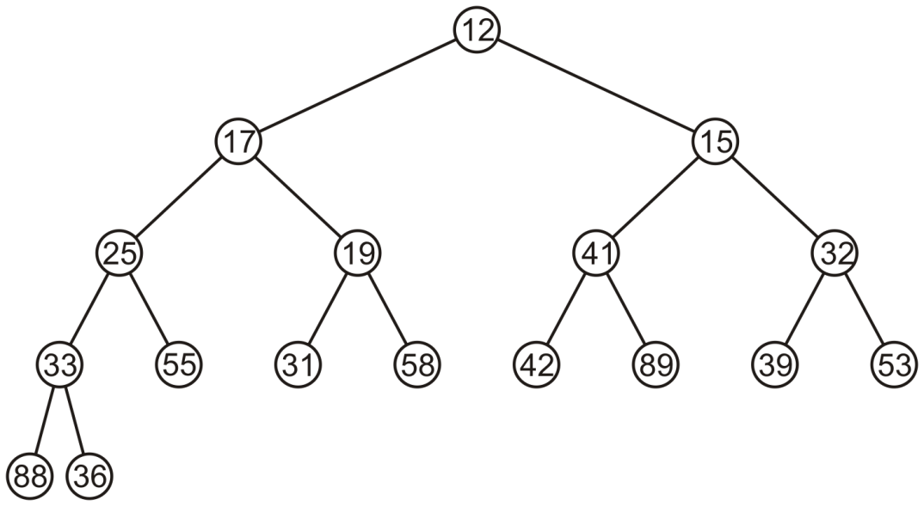
Complete Trees: Pop
Suppose we want to pop the top entry: 12

Slide 32
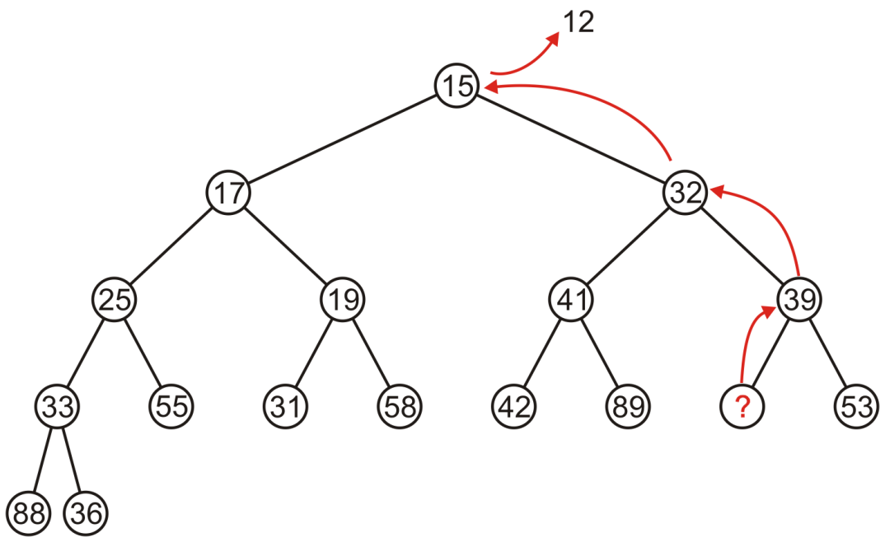
Complete Trees: Pop
Percolating up creates a hole leading to a non-complete tree

Slide 33
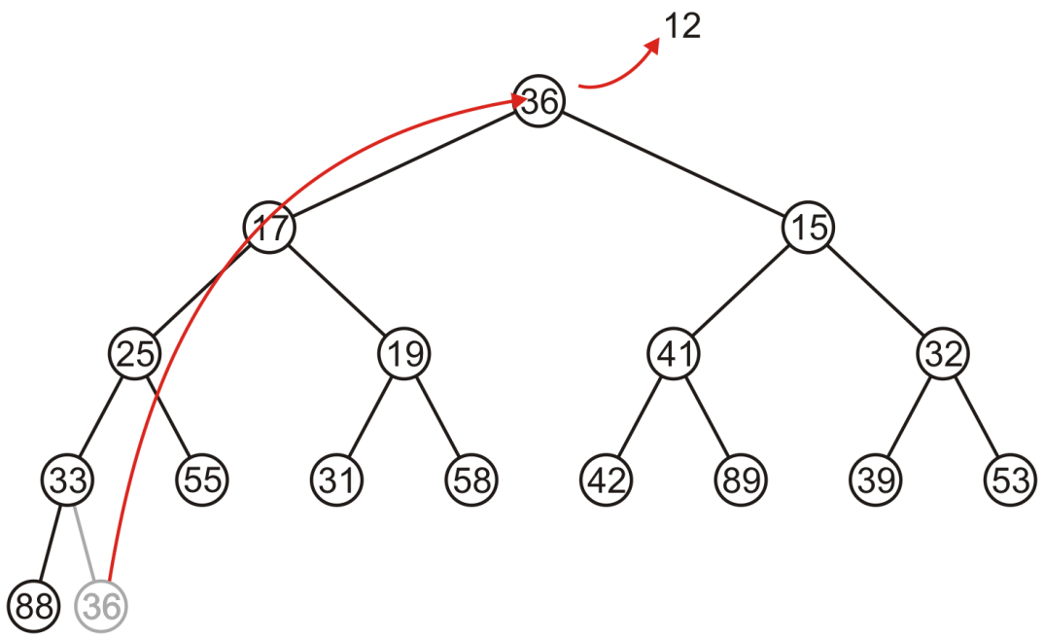
Complete Trees: Pop
Alternatively, copy the last entry in the heap to the root

Slide 34
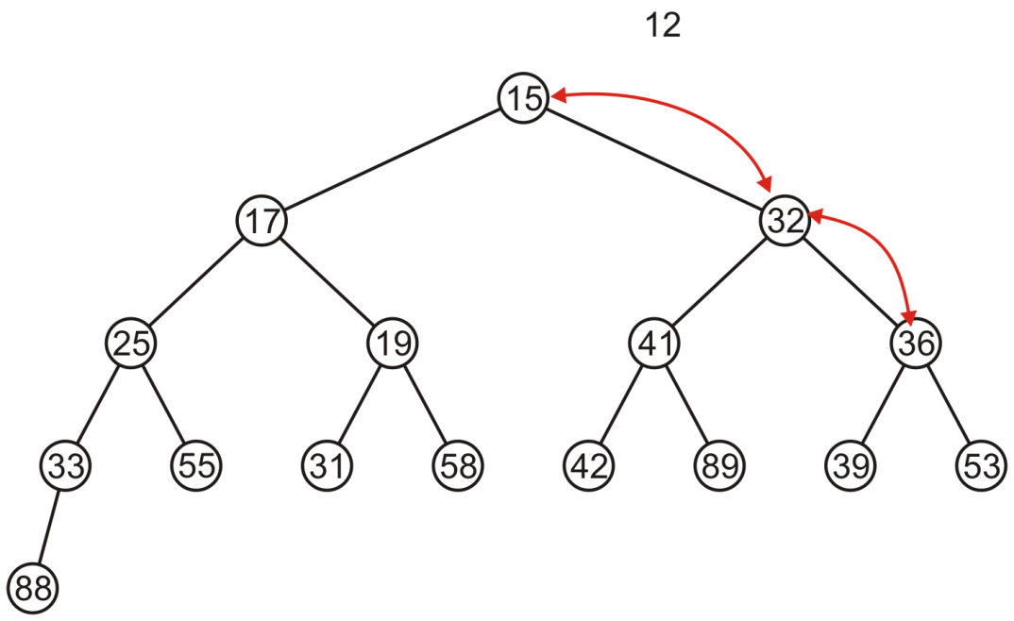
Complete Trees: Pop
Now, percolate 36 down swapping it with the smallest of its children
We halt when both children are larger

Slide 35
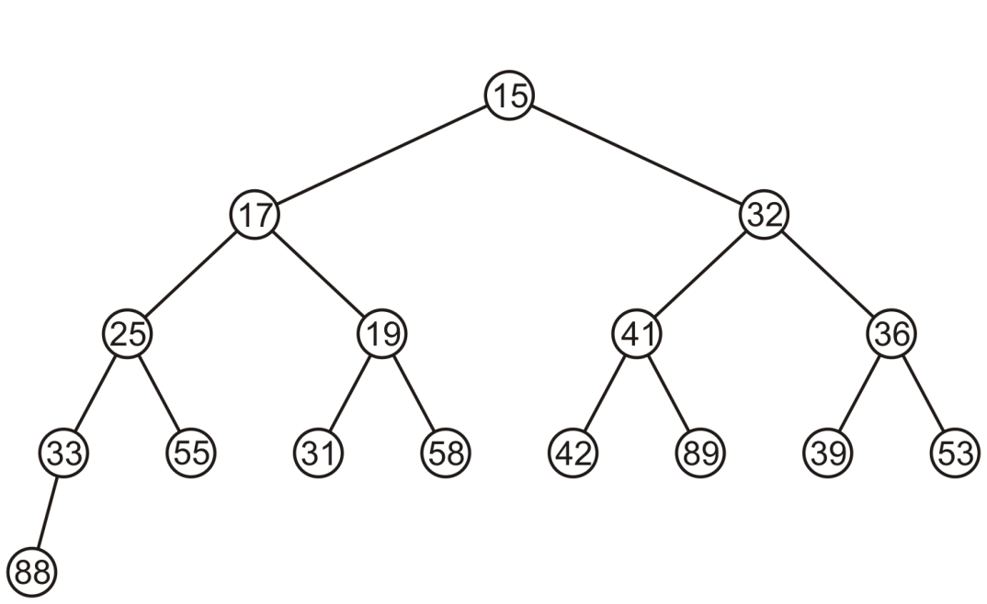
Complete Trees: Pop
The resulting tree is now still a complete tree:

Slide 36
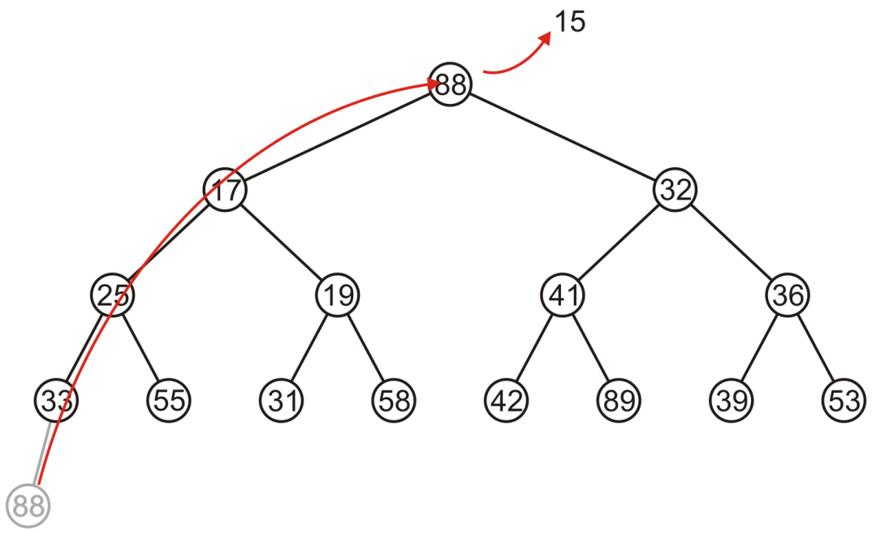
Complete Trees: Pop
Again, popping 15, copy up the last entry: 88

Slide 37
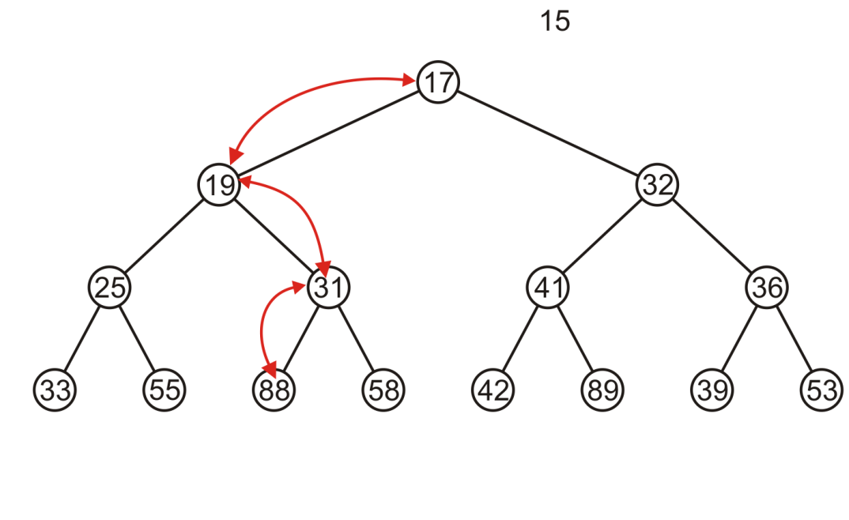
Complete Trees: Pop
This time, it gets percolated down to the point where it has no children

Slide 38
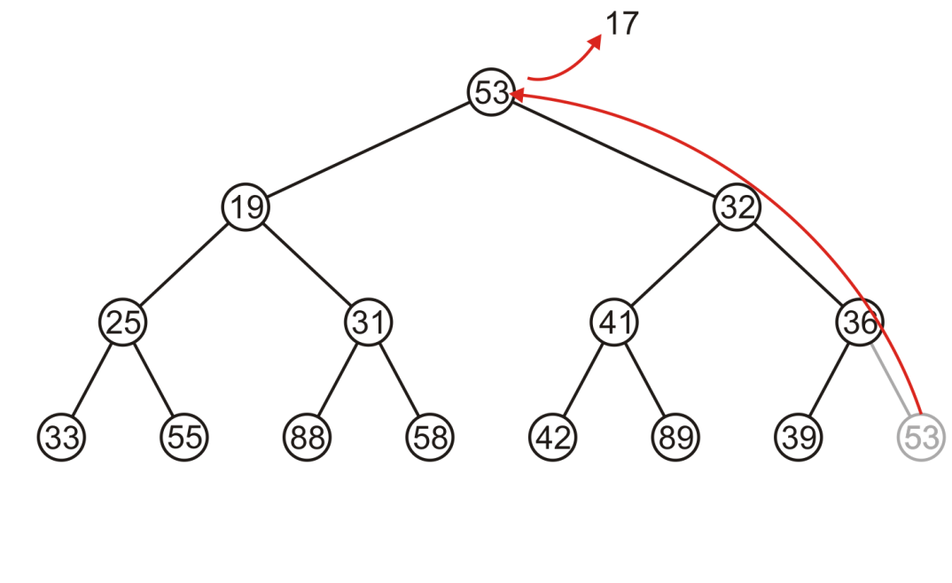
Complete Trees: Pop
In popping 17, 53 is moved to the top

Slide 39
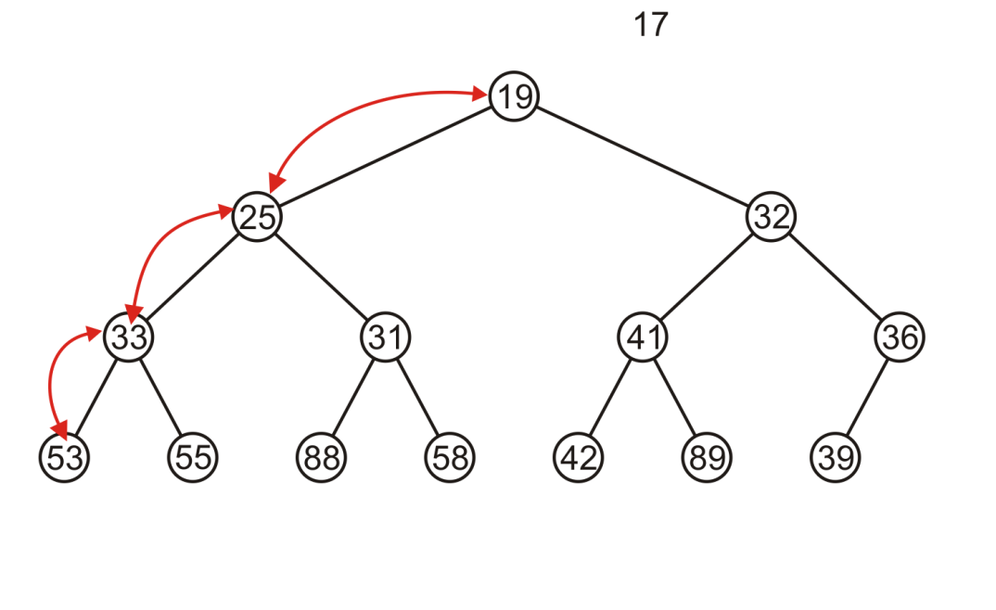
Complete Trees: Pop
And percolated down, again to the deepest level

Slide 40
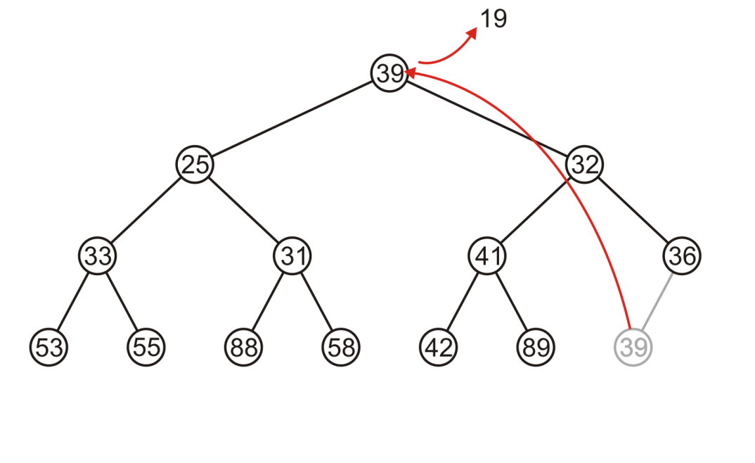
Complete Trees: Pop
Popping 19 copies up 39

Slide 41
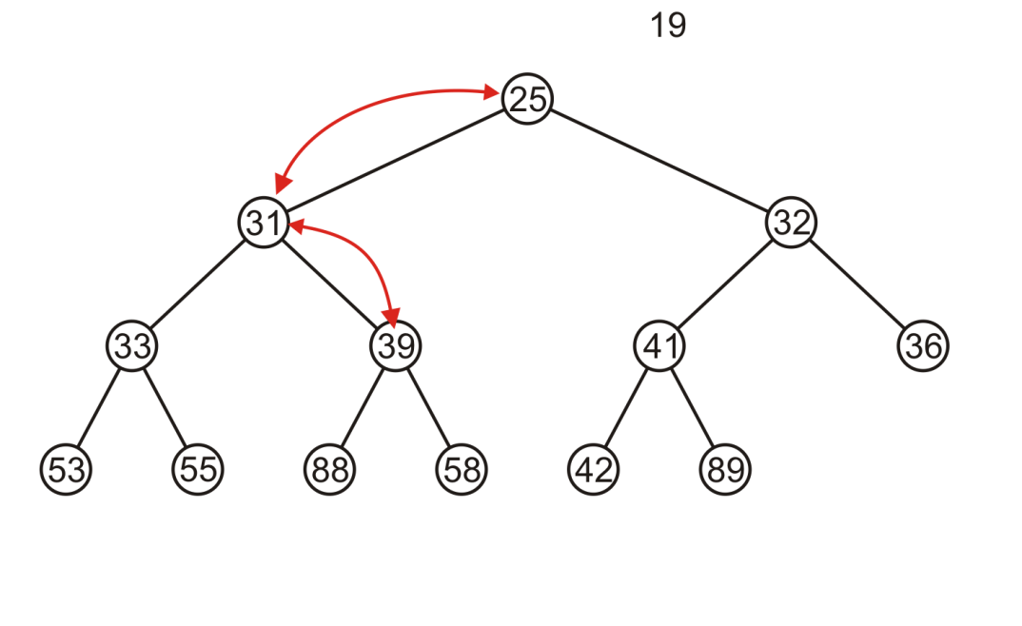
Complete Trees: Pop
Which is then percolated down to the second deepest level

Slide 42
Complete Tree
Therefore, we can maintain the complete-tree shape of a heap
We may store a complete tree using an array:
A complete tree is filled in breadth-first traversal order
The array is filled using breadth-first traversal

Slide 43

Array Implementation
For the heap
a breadth-first traversal yields:

Slide 44
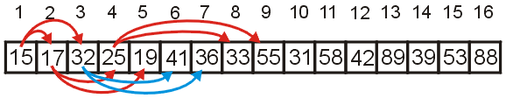
Array Implementation
Recall that If we associate an index–starting at 1–with each entry in the breadth-first traversal, we get:
Given the entry at index k, it follows that:
The parent of node is a k/2 parent = k >> 1;
the children are at 2k and 2k + 1 left_child = k << 1; right_child = left_child | 1;
Cost (trivial): start array at position 1 instead of position 0

Slide 45
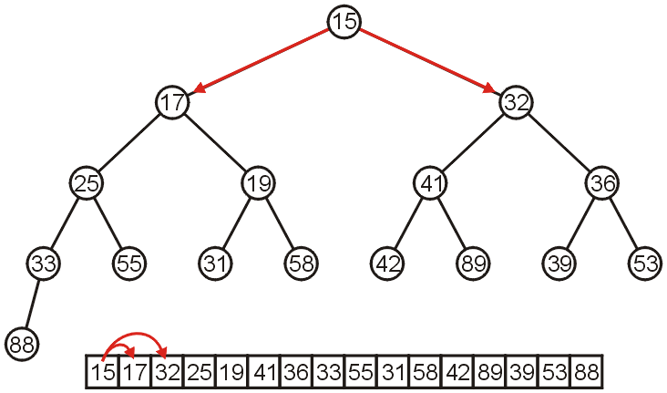
Array Implementation
The children of 15 are 17 and 32:

Slide 46
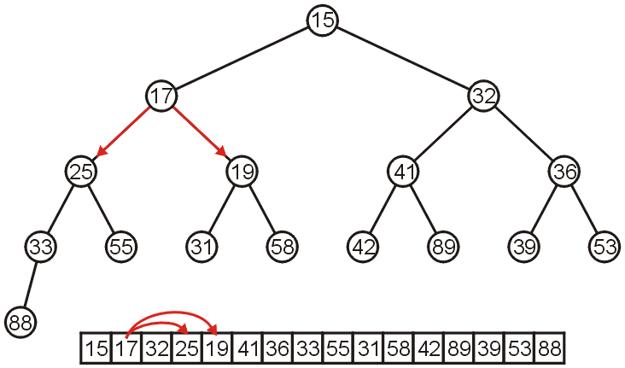
Array Implementation
The children of 17 are 25 and 19:

Slide 47
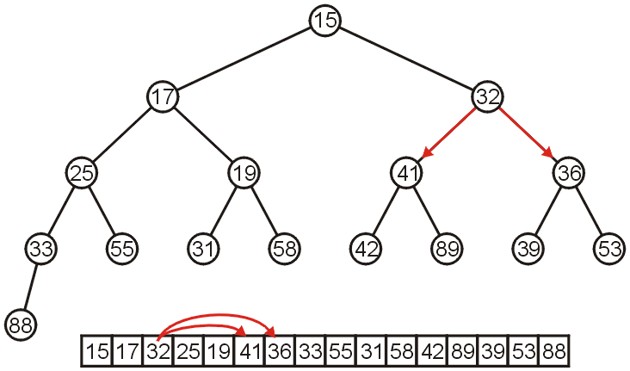
Array Implementation
The children of 32 are 41 and 36:

Slide 48
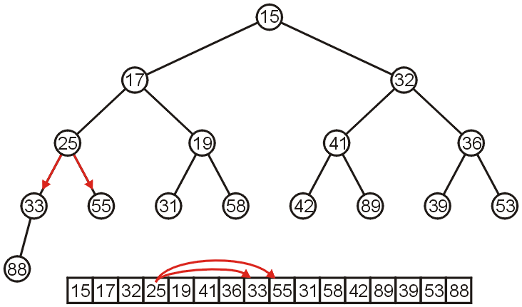
Array Implementation
The children of 25 are 33 and 55:

Slide 49
Array Implementation
If the heap-as-array has count entries, then the next empty node in the corresponding complete tree is at location posn = count + 1
We compare the item at location posn with the item at posn/2
If they are out of order
Swap them, set posn /= 2 and repeat

Slide 50
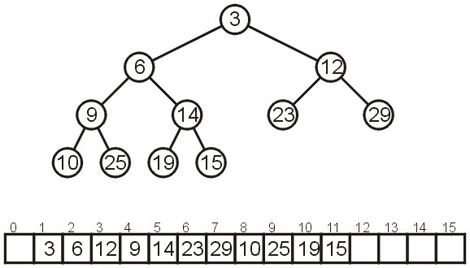
Array Implementation
Consider the following heap, both as a tree and in its array representation

Slide 51
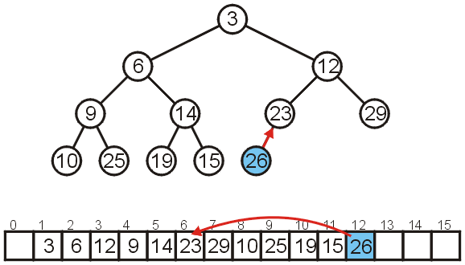
Array Implementation: Push
Inserting 26 requires no changes

Slide 52
Array Implementation: Push
Inserting 8 requires a few percolations:
Swap 8 and 23

Slide 53
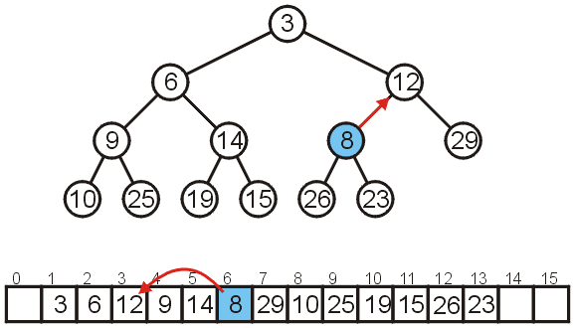
Array Implementation: Push
Swap 8 and 12

Slide 54
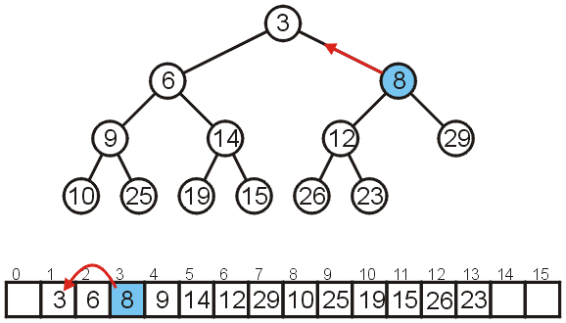
Array Implementation: Push
At this point, it is greater than its parent, so we are finished

Slide 55
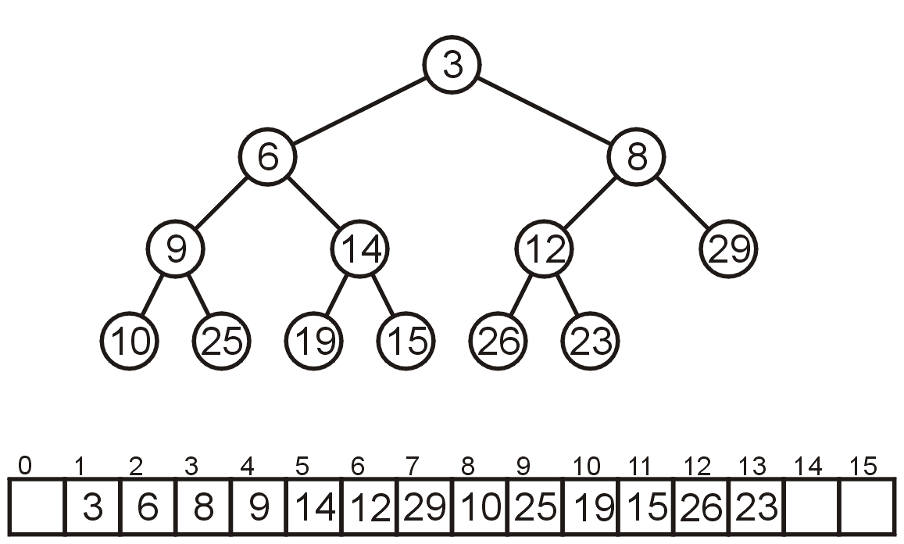
Array Implementation: Pop
As before, popping the top has us copy the last entry to the top

Slide 56
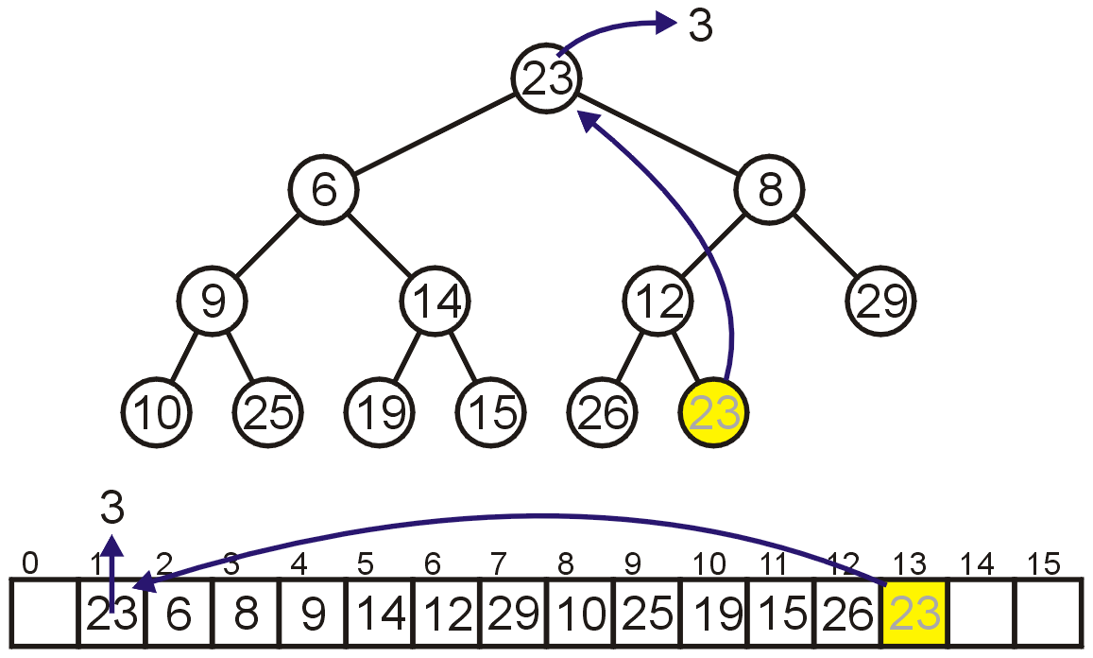
Array Implementation: Pop
Instead, consider this strategy:
Copy the last object, 23, to the root

Slide 57
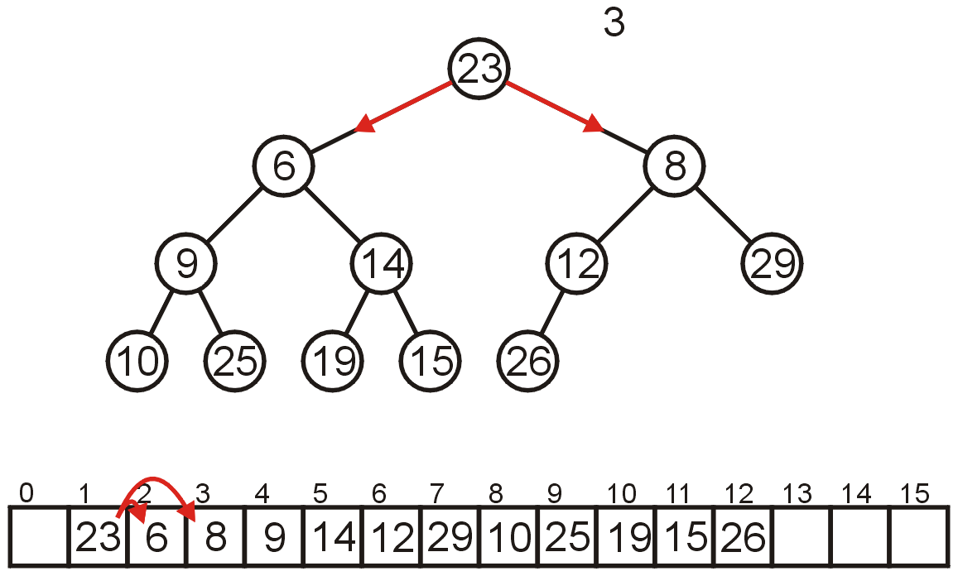
Array Implementation: Pop
Now percolate down
Compare Node 1 with its children: Nodes 2 and 3
Swap 23 and 6

Slide 58
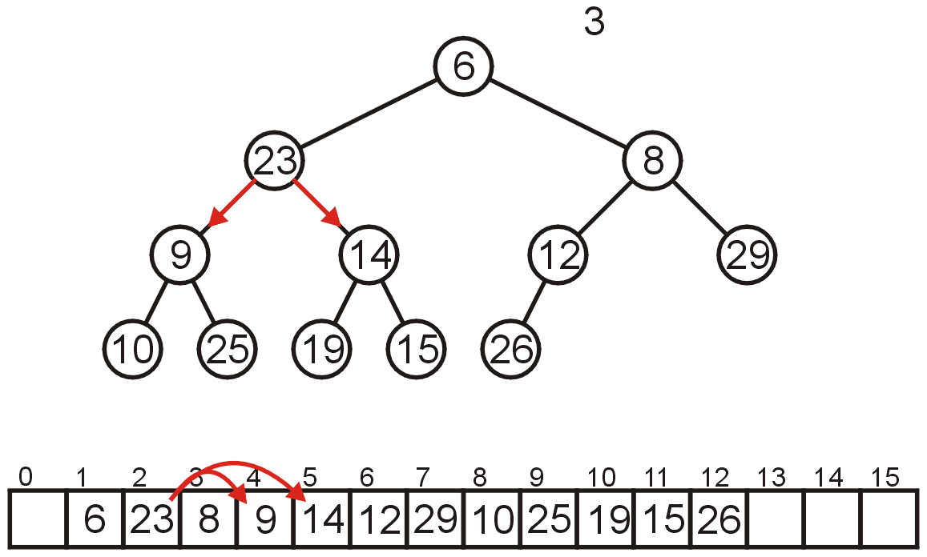
Array Implementation: Pop
Compare Node 2 with its children: Nodes 4 and 5
Swap 23 and 9

Slide 59
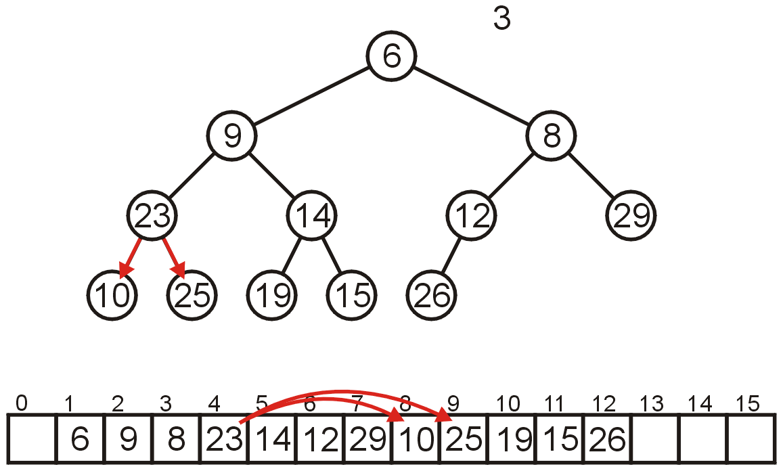
Array Implementation: Pop
Compare Node 4 with its children: Nodes 8 and 9
Swap 23 and 10

Slide 60
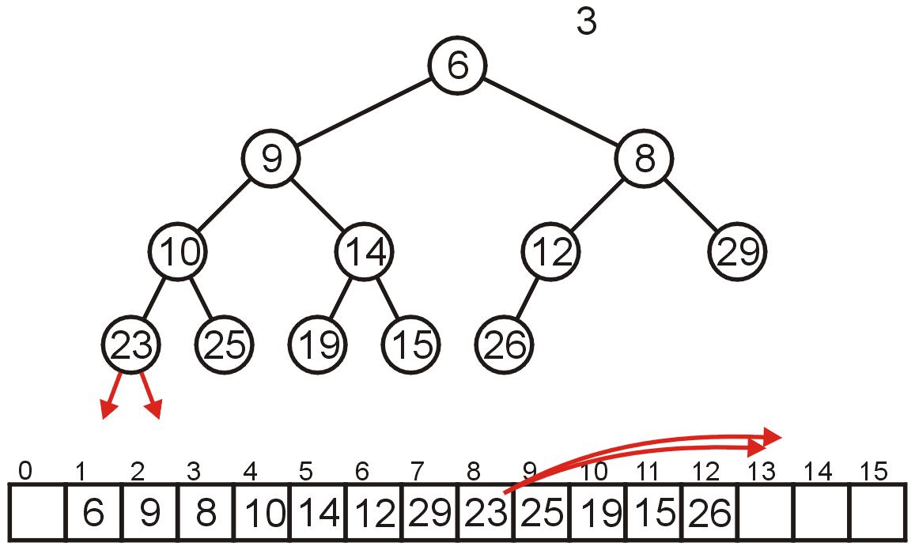
Array Implementation: Pop
The children of Node 8 are beyond the end of the array:
Stop

Slide 61
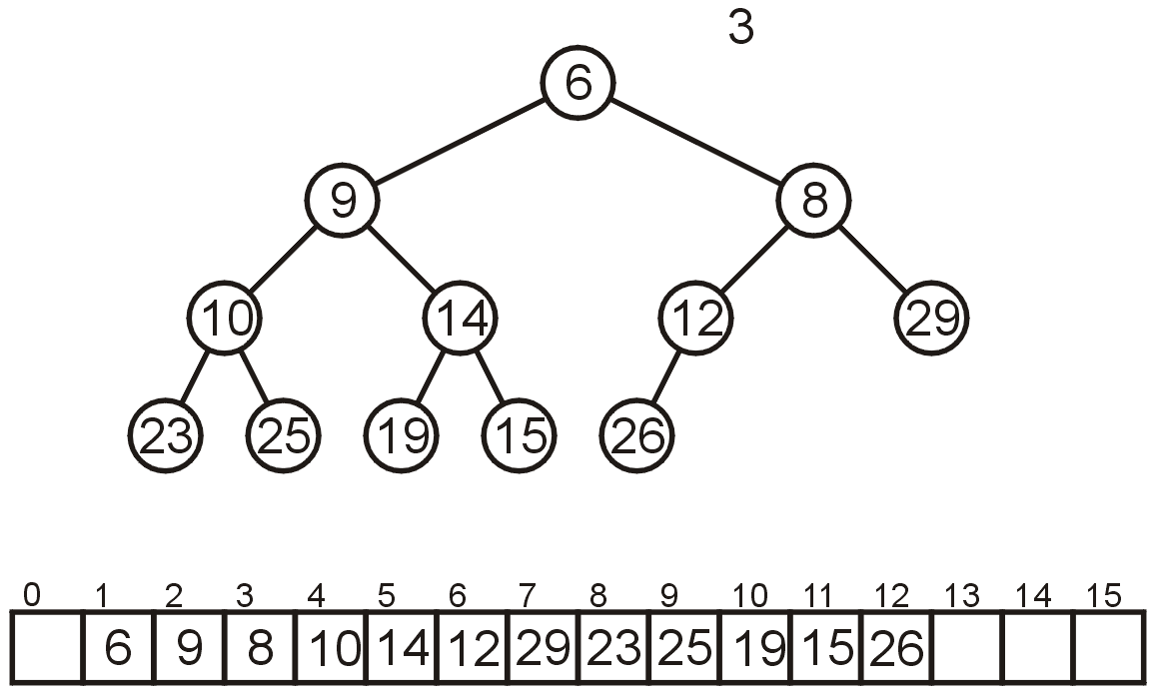
Array Implementation: Pop
The result is a binary min-heap

Slide 62
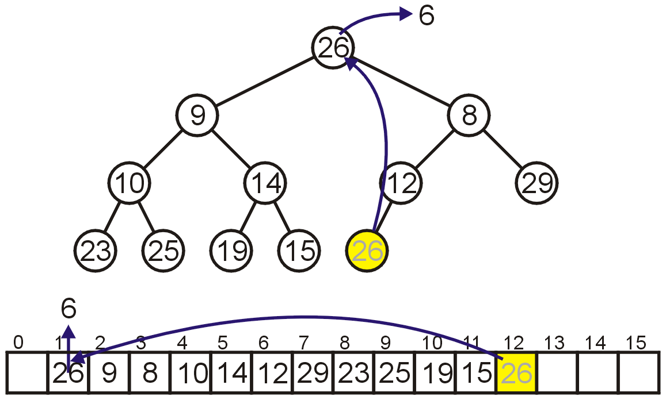
Array Implementation: Pop
Dequeuing the minimum again:
Copy 26 to the root

Slide 63
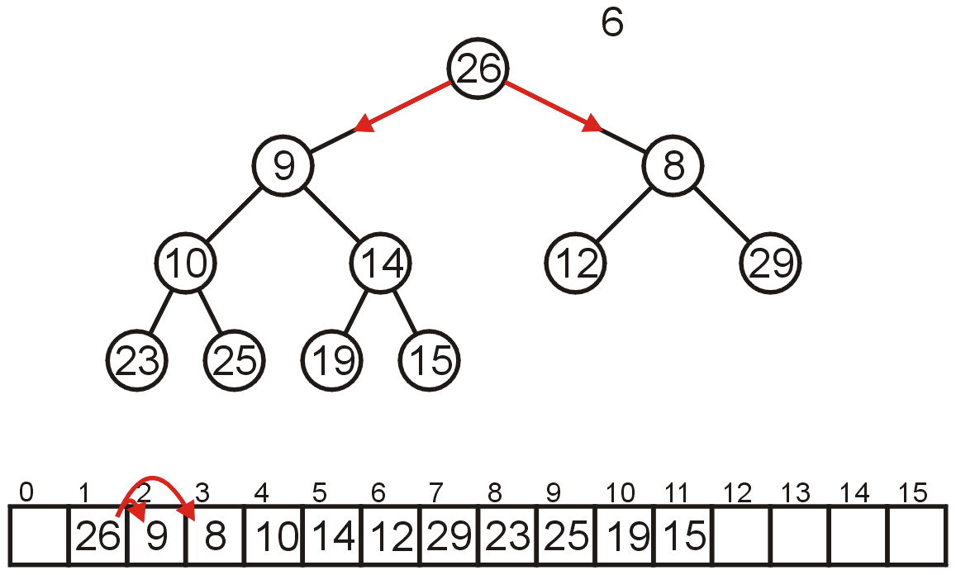
Array Implementation: Pop
Compare Node 1 with its children: Nodes 2 and 3
Swap 26 and 8

Slide 64
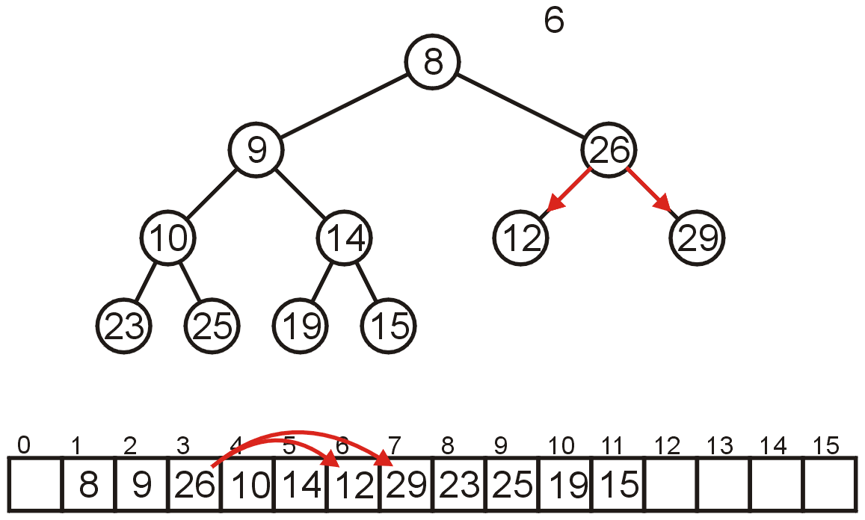
Array Implementation: Pop
Compare Node 3 with its children: Nodes 6 and 7
Swap 26 and 12

Slide 65
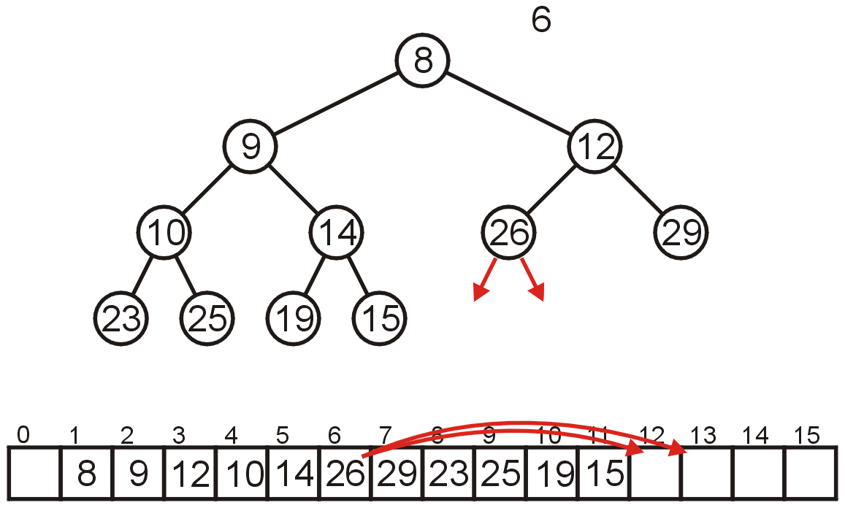
Array Implementation: Pop
The children of Node 6, Nodes 12 and 13 are unoccupied
Currently, count == 11

Slide 66
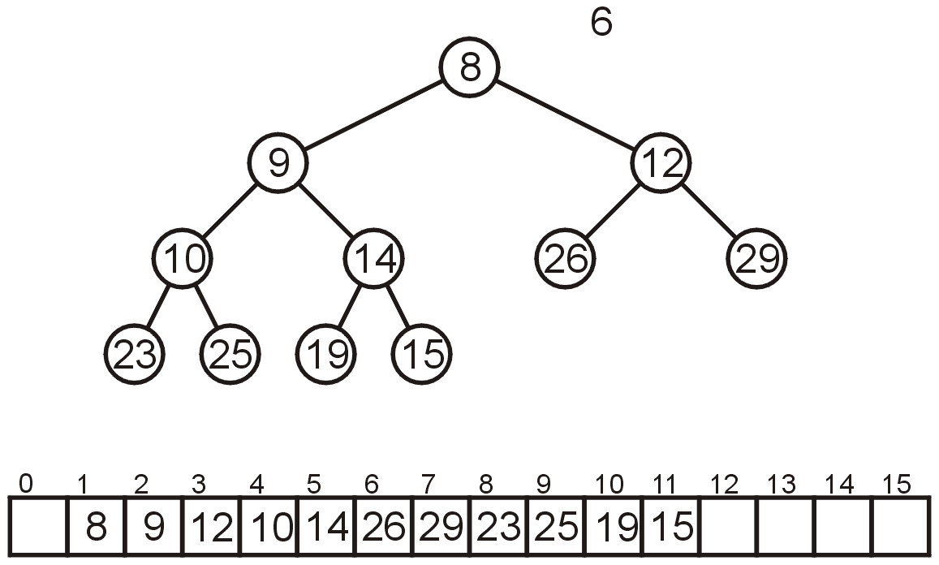
Array Implementation: Pop
The result is a min-heap

Slide 67

Array Implementation: Pop
Dequeuing the minimum a third time:
Copy 15 to the root

Slide 68

Array Implementation: Pop
Compare Node 1 with its children: Nodes 2 and 3
Swap 15 and 9

Slide 69

Array Implementation: Pop
Compare Node 2 with its children: Nodes 4 and 5
Swap 15 and 10

Slide 70

Array Implementation: Pop
Compare Node 4 with its children: Nodes 8 and 9
15 < 23 and 15 < 25 so stop

Slide 71

Array Implementation: Pop
The result is a properly formed binary min-heap

Slide 72

Array Implementation: Pop
After all our modifications, the final heap is

Slide 73
Run-time Analysis
Accessing the top object is Θ(1)
Popping the top object is O(ln(n))
We copy something that is already in the lowest depth—it will likely be moved back to the lowest depth
How about push?

Slide 74
Run-time Analysis
If we are inserting an object less than the root (at the front), then the run time will be Θ(ln(n))
If we insert at the back (greater than any object) then the run time will be Θ(1)
How about an arbitrary insertion?
It will be O(ln(n))? Could the average be less?

Slide 75
Run-time Analysis
With each percolation, it will move an object past half of the remaining entries in the tree
Therefore, after one percolation, it will probably be past half of the entries, and therefore on average will require no more percolations
Therefore, we have an average run time of Θ(1)

Slide 76

Run-time Analysis
An arbitrary removal requires that all entries in the heap be checked: O(n)
A removal of the largest object in the heap still requires all leaf nodes to be checked – there are approximately n/2 leaf nodes: O(n)

Slide 77

Run-time Analysis
Thus, our grid of run times is given by:

Slide 78
Run-time Analysis
Some observations:
Continuously inserting at the front of the heap (i.e., the new object being pushed is less than everything in the heap) causes the run-time to drop to O(ln(n))
If the objects are coming in order of priority, use a regular queue with swapping
Merging two binary heaps of size n is a Θ(n) operation

Slide 79
Run-time Analysis
Other heaps have better run-time characteristics
Leftist, skew, binomial and Fibonacci heaps all use a node-based implementation requiring Θ(n) additional memory
For Fibonacci heaps, the run-time of all operations (including merging two Fibonacci heaps) except pop are Θ(1)

Slide 80

Binary Max Heaps
A binary max-heap is identical to a binary min-heap except that the parent is always larger than either of the children
For example, the same data as before stored as a max-heap yields

Slide 81

Example
Here we have a max-heap of presents under a red-green tree:
http://xkcd.com/835/

Slide 82
Memory allocation and pointer arithmetic
Do we really have to allocate one additional memory location for a binary tree-as-heap?
Type *heap_array = new Type[capacity() + 1];
Could we not just allocate one less memory and point to the previous location in memory
0 | 1 | 2 | 3 | 4 | 5 | 6 | 7 | 8 | 9
heap_array
 | 0 | 1 | 2 | 3 | 4 | 5 | 6 | 7 | 8
heap_array

Slide 83
Memory allocation and pointer arithmetic
To do this, we must understand pointer arithmetic:
int *ptr = new int[5] = {1, 23, 45, 67, 89};
std::cout << ptr << std::endl;
std::cout << *ptr << std::endl;
00d3a260 | 00d3a264 | 00d3a268 | 00d3a26B | 00d3a270
00000001 | 00000017 | 0000002D | 00000043 | 00000059
ptr
What is the output of?
std::cout << (ptr + 1) << std::endl;
std::cout << *(ptr + 1) << std::endl;

Slide 84
Memory allocation and pointer arithmetic
Just adding one to the address would be, in almost all cases, useless
Assuming big endian, this would have a value 256
If this was little endian, it would be even more bizarre…
00d3a260 | 00d3a264 | 00d3a268 | 00d3a26B | 00d3a270
00000001 | 00000017 | 0000002D | 00000043 | 00000059
ptr
What is the output of?
std::cout << (ptr + 1) << std::endl;
std::cout << *(ptr + 1) << std::endl;

Slide 85
Memory allocation and pointer arithmetic
Instead, C and C++ add as many bytes as the size of the object being pointed to
In the cases of int, sizeof( int ) == 4 on most 32-bit machines
The output is 23
00d3a260 | 00d3a264 | 00d3a268 | 00d3a26B | 00d3a270
00000001 | 00000017 | 0000002D | 00000043 | 00000059
ptr
What is the output of?
std::cout << (ptr + 1) << std::endl;
std::cout << *(ptr + 1) << std::endl;

Slide 86
Memory allocation and pointer arithmetic
Essentially, these two statements are identical:
std::cout << ptr[i] << std::endl;
std::cout << *(ptr + i) << std::endl;
Now you can do the following:
Type *tmp = new Type[capacity()];
Type *heap_array = tmp - 1;
Now, heap_array[1]; and tmp[0]; both point to the same memory location
00d3a260 | 00d3a264 | 00d3a268 | 00d3a26B | 00d3a270
00000001 | 00000017 | 0000002D | 00000043 | 00000059
heap_array
tmp

Slide 87
Memory allocation and pointer arithmetic
Issues:
Never access or modify the contents of heap_array[0]
When you deallocate memory, you must point to the original address returned by new:
delete [] (heap_array + 1);
Pointer arithmetic is not for the faint of heart but it is fun; for example:
int array[N];
int *ptr = array;
// Print all the entries of the array
for ( int i = 0; i < N; ++i ) {
std::cout << *(ptr++) << std::endl;
}

Slide 88
Priority Queues
Now, does using a heap ensure that that object in the heap which:
has the highest priority, and
of that highest priority, has been in the heap the longest
Consider inserting seven objects, all of the same priority (colour indicates order):
2, 2, 2, 2, 2, 2, 2

Slide 89

Priority Queues
Whatever algorithm we use for promoting must ensure that the first object remains in the root position
Thus, we must use an insertion technique where we only percolate up if the priority is lower
The result:
Challenge:
Come up with an algorithm which removes all seven objects in the original order

Slide 90

Lexicographical Ordering
A better solution is to modify the priority:
Track the number of insertions with a counter k (initially 0)
For each insertion with priority n, create a hybrid priority (n, k) where:
(n₁, k₁) < (n₂, k₂) if n₁ < n₂ or (n₁ = n₂ and k₁ < k₂)

Slide 91
Priority Queues
Removing the objects would be in the following order:

Slide 92

Priority Queues
Popped: 2
First, (2,1) < (2, 2) and (2, 3) < (2, 4)

Slide 93

Priority Queues
Removing the objects would be in the following order:

Slide 94

Priority Queues
Removing the objects would be in the following order:

Slide 95

Priority Queues
Removing the objects would be in the following order:

Slide 96

Priority Queues
Removing the objects would be in the following order:

Slide 97
Summary
In this talk, we have:
Discussed binary heaps
Looked at an implementation using arrays
Analyzed the run time:
Head Θ(1)
Push Θ(1) average
Pop O(ln(n))
Discussed implementing priority queues using binary heaps
The use of a lexicographical ordering

